Slide 1


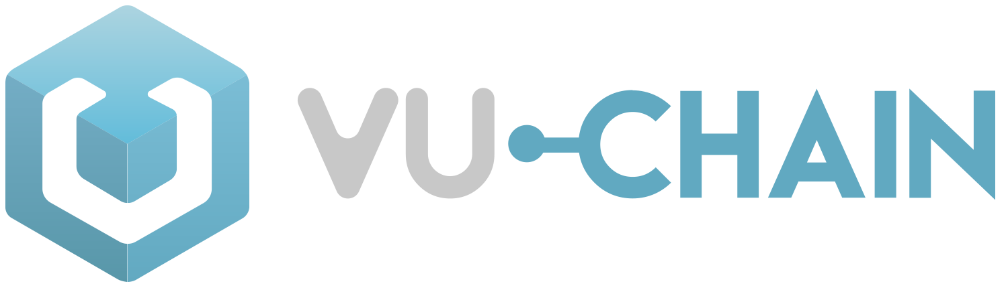
The NFT collection for the sale of physical gold and the creation of the first Crypto - Gold Exchange with tokenization of assets and business

Slide 2

01
BASIC INFORMATION
This paper has the purpose to outline the basic aspects of the commercial targeting and technologies underlying the MTC project through OrusX NFT collection

Slide 3
WAIVER OF LIABILITY
This white paper describes the technical and practical aspects of MTC project. The information contained in this white paper is not exhaustive and does not imply any contractual relationship.
This document is not binding for Metal Trading Company (MTC) and its affiliates. MTC reserves the right to make future changes and updates by uploading an updated white paper on the Orus X website (http://OrusX.com/).
Our publications do not offer investment advice and nothing in them should be construed as in- vestment advice. Our publications provide information and education for investors who can make their investment decisions without advice.
The information contained in our publications is not, and should not be read as, an offer or rec- commendation to buy or sell or a solicitation of an offer or recommendation to buy or sell any securities. Our publications are not, and should not be seen as, a recommendation to use any particular investment strategy.
You should carry out your own independent research before making any investment decision. Our publications do not take the specific needs, investment objectives and financial situation of any particular individual into consideration and any investments mentioned may not be suitable for you. You should not base any investment decision solely on the basis of the information that we publish
Orus X -NFT’s holders are fully responsible for determining whether they can buy, hold or trade Orus X NFT within their jurisdiction.

Slide 4
02
PROJECT CONCEPT DESCRIPTION

Slide 5
The Metal Trading Company “ MTC” has established lasting relationships with African mining companies, as well as with collectors and metal distributors. It has strong connections worldwide with major international metal traders. MTC plans to become an ideal partner for all players involved in the Gold market. With Orus X NFT Collection, the company also intends to position itself in a leading position as a trading crypto-Gold platform.
Home page | http://orusx.com/
E-mail | info@vu-chain.com
Social network | https://twitter.com/orusx
Telegram Channel | https://t.me/orusx

Slide 6
PHYSICAL GOLD BUYERS
MTC Metal Trading Company, through Orus X NFT’s collection, will gain sufficient capital to leverage the company’s solid network of contacts and experience in the gold trade sector, aiming to achieve high returns with very limited risks. This capital will be used to finance the company’s gold trading and to potentially produce an average monthly margin on sales of 5-7% from it. Particularly, 3% of monthly margin on sales out of 7% will be shared throughout the investors/the owners of the NFT. The gold trading consists of:
A. Purchase of gold ingots from a Good Delivery operator
B. Sale of gold ingots to Customers on MTC’s own Platform
C. Delivery of purchased ingots upon customer’s request.
A dashboard with real time information will be carried out and available to access from each NFT’s owner to check for any variation and return on the capital invested by MTC on the gold trading and consequently develop evaluations concerning the NFT’s market value and retained earning.
Gold is a unique asset: highly liquid, yet scarce; it’s a luxury asset as much as a hedge against inflation. This last aspect is one of the main drivers of today’s gold investors. Unlike paper currency, coins or other assets, gold has maintained its value throughout the ages. People see gold to pass on and preserve their wealth from one generation to the next. Since ancient times, people have valued the unique properties of precious metals.
Currently Gold is seen as the most secure asset to protect capital against the current financial crises.
Gold, being a physical asset, does come with its own challenges that MTC has carefully considered in order to make it more available for investors and better protect their capital at the same time.

Slide 7
OrusX NFT COLLECTION OFFERING DETAILS
Name: Orus X
Symbol: ORX
Pre STO Sales: Within December 15°, 2023
Private Sales: Within January 15°, 2024
Maximum emission Pre Sale: 5.000 NFT
Maximum Emission Private Sales: 5.000 NFT

Slide 8
WHAT BUYERS NEED | WHAT METAL TRADING COMPANY OFFERS
Ownership | The gold deposited in the MTC wallet will be held by our partner Swiss Bank under the user's name, this will protect ownership against any adverse event involving MTC. The Bank will be keeping the ledger of the gold guaranteeing ownership to the customers but the physical gold will be held directly by our Swiss Good Delivery Partner. Using this structure we make sure the users have a guaranteed ownership of the physical metal and that they are fully protected by adverse events happening to MTC and/or the Bank. We only work with the largest and most trusted Gold Operator in the world.
Availability of the metal | Users can request delivery of the owned gold at any point in time by a simple request on the platform. The gold will then be delivered within 72 hours in any part of the world* (most countries have 24 hours delivery guarantee)
Liquidity | Investors can buy gold and request delivery in 100gr increments (ingots). Nobody wants to run around with a kilo bar in a harsh crisis.

Slide 9
WHAT BUYERS NEED | WHAT METAL TRADING COMPANY OFFERS
Supplier reliability | We only work with the most reliable partners in the sector. Users will always know the details of the partner that is guaranteeing their ownership rights and the partner that is guaranteeing and storing their metal.
Compliance with the Law | MTC will always ensure compliance with legislation and in this respect it makes sure to work only with the most recognised and secure partners. MTC, before starting operations, will be fully regulated by FINMA (Swiss Financial Market Supervisory Authority).
Management and storing of physical gold | Storing and managing the metal is always expensive and logistically challenging. This is why MTC offers storage services and all this at no cost to the users.
Quality control | Gold being a physical asset is subject to risks of low quality and falsifications. MTC by collaborating only with the largest, most reliable and secure partners in the market, guarantees the quality of the gold and eliminates the risk of low quality or falsification.

Slide 10
CRYPTO-GOLD EXCHANGE
The second part of the project will be the creation of an exchange platform for trading gold with NFTs and cryptocurrencies, which would represent an innovative platform in the current worldwide market. Metal Trading Company, through Orus X NFT’s collection, will create the world’s first platform for the direct exchange between crypto and gold with the option to store the precious metal and receive it physically quickly and stress free, all this with a full guarantee on its provenance and quality. This will be carried out using a proprietary platform that combines the advantages of centralized and decentralized exchanges. To forecast the return of the project and show its great potential, we have detailed a possible turnover that will be generated by our platform by forecasting our typical customer behavior.
The average forecast profit percentage, for every euro that enters the platform, is 2.38%. By multiplying the average profit by the two operations that each customer is expected to carry out, we will have 4.76% profit for each euro that enters the platform. We expect an overall volume of transaction for MTC of approximately 150,000,000.00 € (HUNDRED MILLIONS / 00 Euro) in the first year. 5% of the yearly return from the exchange platform will be shared throughout the investors/the owners of the NFT belonging to the first collection sold.

Slide 11
KEY FEATURES OF THE MTC’S CRYPTOGRAPHIC EXCHANGE
High transaction speed | High transaction speed The trading engine of the platform will be able to process thousands of (tens, hundreds, millions) of trade warrants simultaneously. The deal will be practically instant
Simplicity of the sales process | The purchase and sale of crypto assets on the MTC exchange will be similar to that offered by the most important cryptocurrency exchanges such as Binance and Coinbase. Trade in physical gold will be simple and secure with a full guarantee of ownership
Extensive trade functionalism | Indicators, trading signals, customizable schedules and other tools for traders will be implemented in the platform interface
High liquidity | MTC will be supporting the liquidity of the Exchange allocating a large portion of the Funds to it. We have in place an aggressive and customer oriented growth plan that will bring MTC exchange in the same league with the most liquid exchanges in the market.
Safety | All best security practices are put in place by MTC. Starting from a full Audit of its Smart Contract and Platform, to a full security framework to protect users data and funds by any external threat. MTC will monitor and continuously improve its security practice and has a regular audit schedule to make sure no aspect gets overlooked.

Slide 12
PURCHASE OF PHYSICAL GOLD
Using the MTC-wallet, users will be able to buy, store, exchange and request delivery of physical Gold. The Gold will be available for purchase at the current market price. The purchase/trading process will be simple and the users will be able to buy Gold using selected FIAT currencies and MTCG tokens.
The owned Gold will be visible in the MTC-wallet and can be traded against FIAT currencies and MTCG tokens.
Users, through a simple process can request, at any time, delivery of their physical Gold. MTC guarantees delivery within 72 hours in any part of the world* (with many countries served within a 24 hours time frame). The Gold will be supplied in stamped and numbered ingots of minimum 100 grams, this being the minimum quantity that can be ordered.
To protect the users for any unfortunate event that may involve MTC, all MTC centralized wal lets will be held by our partner Swiss Bank that will guarantee users the full ownership of funds.
The physical gold delivery, its quality and its provenance will be guaranteed by our Swiss Good Delivery partner that will protect, together with the Swiss Bank, users from any negative event that may involve MTC. MTC is also in the process of registering with FINMA, the Swiss Financial Market Supervisory Authority before starting its financial activities.
By taking all the above steps and precautions, MTC is auto-regulating itself voluntarily adhering to most stringent financial regulations, all this to fully protect the users and their funds. MTC has created a system where the user’s funds and Gold will be fully protected and always redeemable by the users, also in any unfortunate event that may involve MTC.
Physical gold will always be purchased by MTC in accordance with the main international rules for the “responsible search” of precious metal suppliers; through transparent monitoring and control of the supply chain from production to end use; conformity with all norms and standards LBMA, OECD and World Gold Council Conflict-Free Gold Standard.
A full Auditing process has been put in place, to ensure full transparency is offered to the customers.

Slide 13
PURCHASE OF PHYSICAL GOLD
Using the MTC-wallet, users will be able to buy, store, exchange and request delivery of physical Gold. The Gold will be available for purchase at the current market price. The purchase/trading process will be simple and the users will be able to buy Gold using selected FIAT currencies and MTCG tokens.
The owned Gold will be visible in the MTC-wallet and can be traded against FIAT currencies and MTCG tokens.
Users, through a simple process can request, at any time, delivery of their physical Gold. MTC guarantees delivery within 72 hours in any part of the world* (with many countries served within a 24 hours time frame). The Gold will be supplied in stamped and numbered ingots of minimum 100 grams, this being the minimum quantity that can be ordered.
To protect the users for any unfortunate event that may involve MTC, all MTC centralized wal lets will be held by our partner Swiss Bank that will guarantee users the full ownership of funds.
The physical gold delivery, its quality and its provenance will be guaranteed by our Swiss Good Delivery partner that will protect, together with the Swiss Bank, users from any negative event that may involve MTC. MTC is also in the process of registering with FINMA, the Swiss Financial Market Supervisory Authority before starting its financial activities.
By taking all the above steps and precautions, MTC is auto-regulating itself voluntarily adhering to most stringent financial regulations, all this to fully protect the users and their funds. MTC has created a system where the user’s funds and Gold will be fully protected and always redeemable by the users, also in any unfortunate event that may involve MTC.
Physical gold will always be purchased by MTC in accordance with the main international rules for the “responsible search” of precious metal suppliers; through transparent monitoring and control of the supply chain from production to end use; conformity with all norms and standards LBMA, OECD and World Gold Council Conflict-Free Gold Standard.
A full Auditing process has been put in place, to ensure full transparency is offered to the customers.

Slide 14
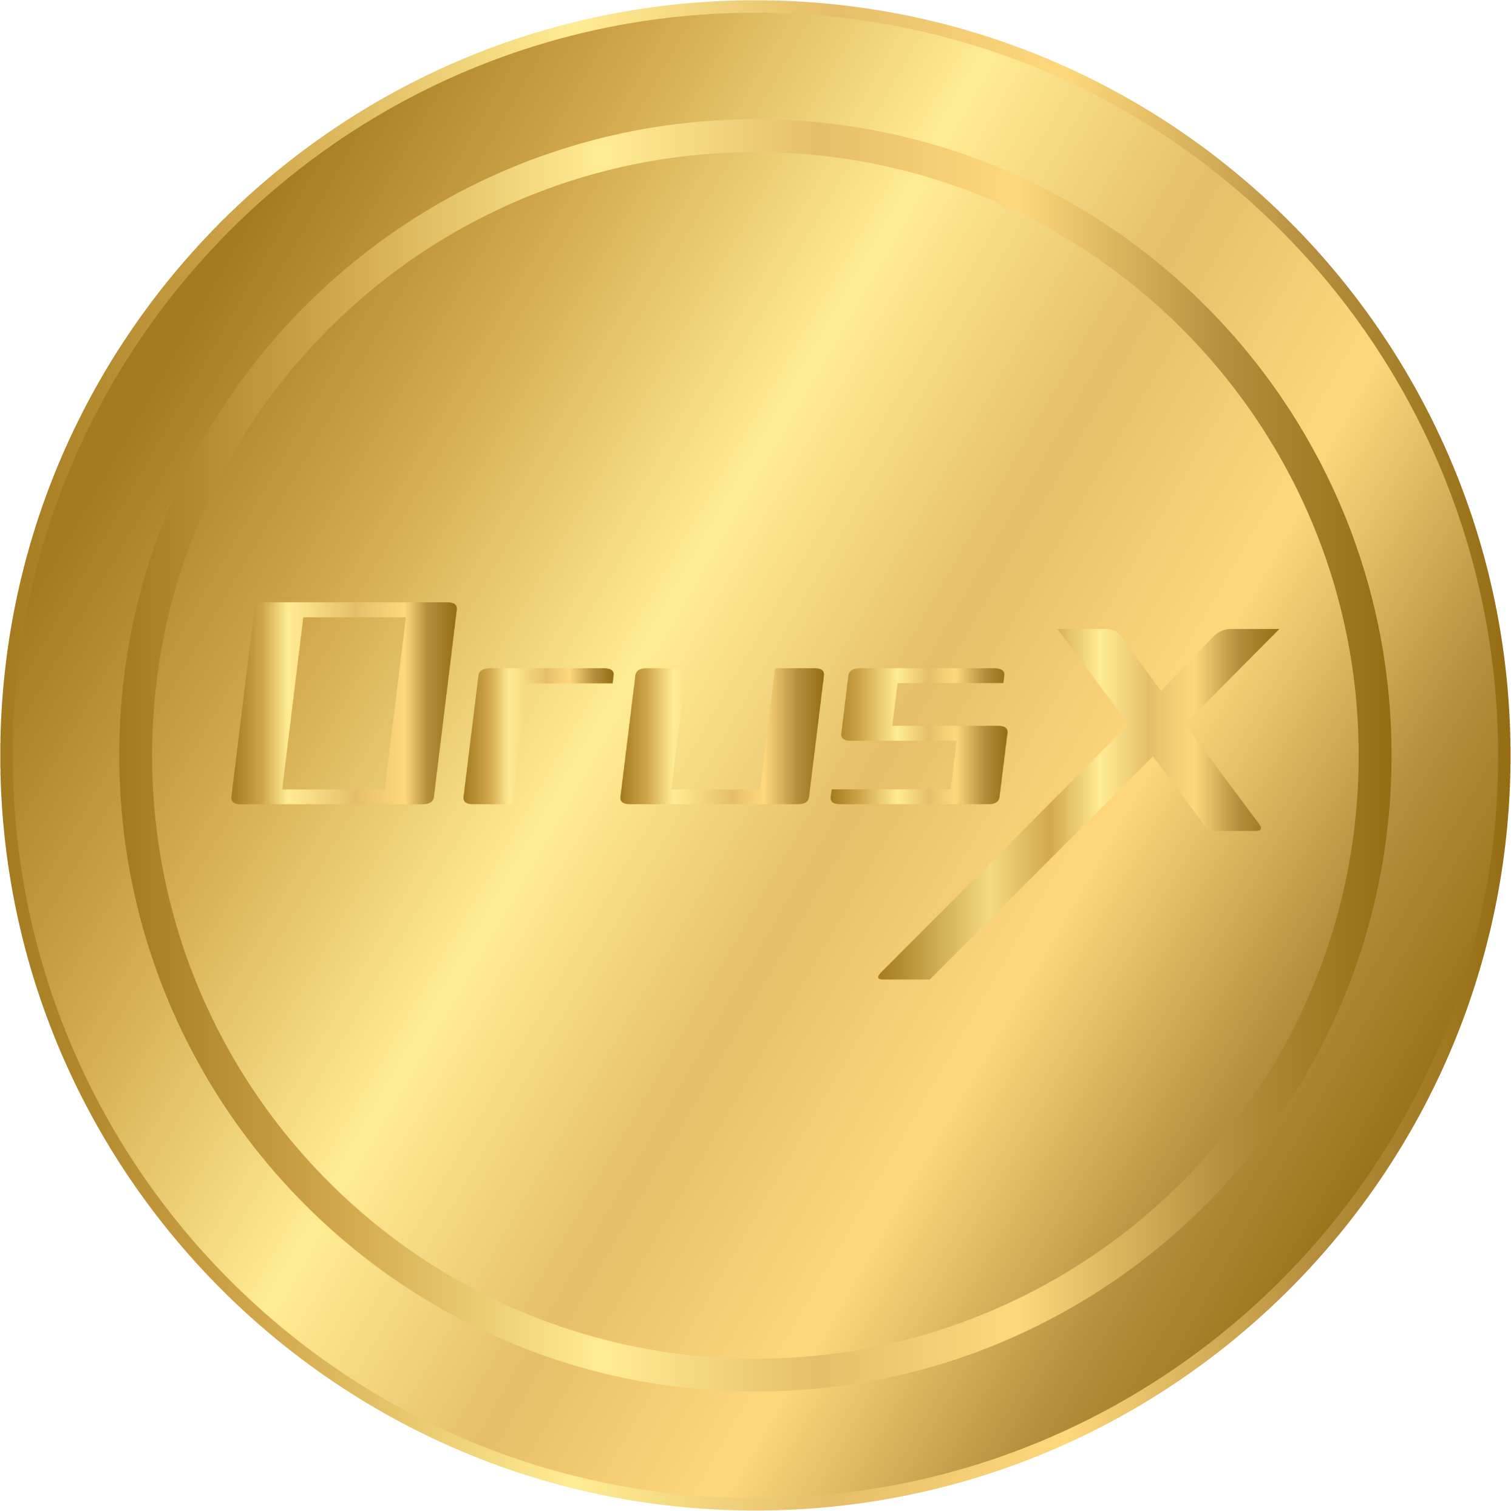
03
ANALYSIS OF THE TARGET MARKET AND AUDIENCE
As a crypto-gold trading platform with the possibility of direct purchases of physical gold and the tokenization of assets, MTC’s user base is very large and includes any person and/or business interested in the Crypto and Gold market.

Slide 15
TOKENIZATION OF BUSINESS AND ASSETS
As further development in the pipeline, MTC will introduce tools through which businesses can easily and rapidly capitalize on their own assets, goods and services. These tools will allow busi- nesses to digitize their assets generating tokens that can eventually be used to represent owner- ship or participation in these assets. The “Tokenization of Assets” will have specific advantages for the business and its users:
Liquidity | Will make it possible to divide the cost of an asset into a defined number of units. As a result, the Business will be able to access market liquidity for its development and expansions and the users will have easy access to a tradable and accessible tool that will allow the participation into the business success.
Programmable | The blockchain technology, compared with the traditional tools in the stock market, allows the introduction of simple business logic into smart contracts, which can automate most of the workflow and business processes in a decentralized system that will guarantee all participants from possible fraudulent manipulations. This will also automate processes increasing the speed of operations / actions together with a decrease in costs.
Invariability | The data in the blockchain cannot be changed or removed, and the transaction records leaves always a public trail. This avoiding possibilities of fraud and errors.

Slide 16
TOKEN HOLDERS ADDITIONAL BENEFITS
MT-COIN Tokens will allow the holders to take part in the success of the MTC Platform and a mechanism of dividend distribution will also be put in place. The volume of dividends will be governed by a Smart Contract with a specific formula based on the ownership lenght and volume of token owned. All rules and functionalities will be disclosed after the FINMA authorisation.

Slide 17
CRYPTO TRADERS
The average cryptocurrency exhange user bases its preference over a specific exchange, on the following aspects:
WHAT TRADERS NEED | WHAT OFFER MTC
security | All best security practices are put in place by MTC. Starting from a full Audit of its Smart Contract and Platform, to a full security framework to protect users data and funds by any external threat. MTC will monitor and continuously improve its security practice and has a regular audit schedule to make sure no aspect gets overlooked.
High liquidity | MTC will be allocating a large part of its capital to ensure a base of liquidity will always be present on the exchange and our growth plan will ensure that we will become one of the exchanges with the highest liquidity in the market.
Easiness of use | MTC exchange is built with ease of use in mind and it is continuously developed in order to make it and maintain the most user friendly possible.
Low commissions | MTC will always adapt and keep its commissions at the lower end of the market.
Good quality support | MTC offers a network of Ambassadors in each Country always ready to help and support the users offering a fully personalised support.
Trust | MTC, in order to build trust and fully protect user’s capital, is being regulated by FINMA (Swiss Financial Market Supervisory Authority). MTC is also partnering with an important Swiss Bank that will be auditing its operations and that will be holding users’ funds to protect them by any adverse event.

Slide 18
04
TOKEN TECHNOLOGY AND ECONOMY
MTCG is an ERC-20 token, released on the Ethereum blockchain. ERC-20 is the Ethereum Smart Contract that controls the main characteristics of the tokens (name, symbol, decimal precision), trace the total number of tokens, trace the tokens for each address, and allow addresses to be transferred to each other.

Slide 19
TOKENIZATION
MTC is quickly expanding its services to offer services of tokenization of Company and/or specific Assets. Tokenization will allow the Funding of projects of entire companies using the infrastructure and security offered by the Blockchain technology. To tokenize assets many different aspects need to be considered i.e. financial, operational, legal etc. MTC will cover all of the necessary aspects of tokenization making it a painless process and in full respect of privacy and security for the company and its users. More announcements on this will soon come from MTC.

Slide 20
05
DETAILS AND CONDITIONS OF STO MTCG

Slide 21
We provide the principal asset custody services, advanced trading features, and proven security procedures aiming to protect customer databases, digital asset inventory, order book, and order reconciliation engine. Two Factor authentication (2FA) is the foundation of fraud prevention and account security. Pre- vent fraudulent account creation and make sure that your digital assets are safe, secure. Know Your Customer (KYC) procedures are a critical function to assess customer risk and a legal requirement. We use best practices in:
• DDoS protection
• Anti-phishing
• Protection against SQL-injection
• JWT token session expiry with user re-login
• Withdraw confirmation from admin
• Admin IP restriction
Hot wallet to Cold wallet system to prevent funds leakage risks Hot wallet funds can be manually withdrawn to external addresses (all this to avoid storing financial funds on the platform) . If necessary, funds can be returned to the hot wallet any time.

Slide 22
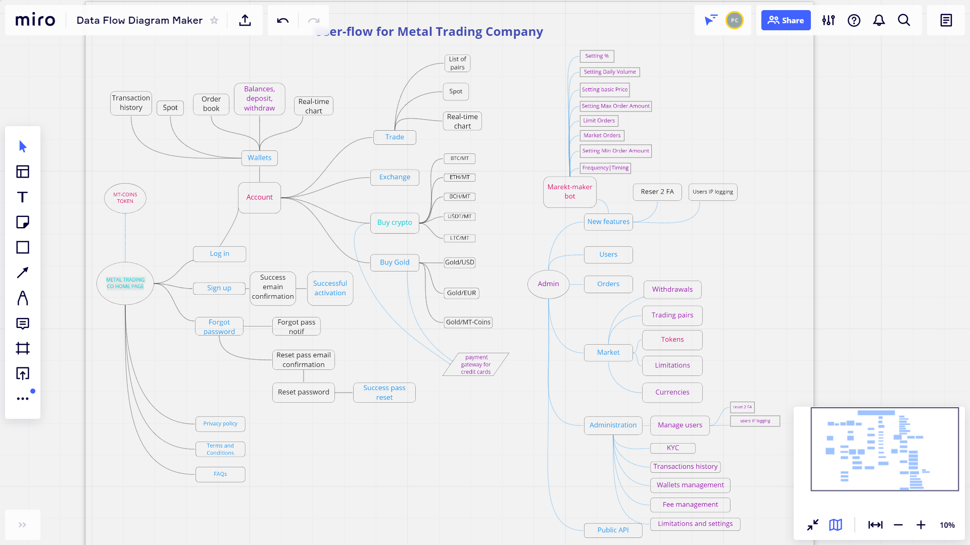
FLOWCHART OF THE CRYPTO-GOLD EXCHANGE

Slide 23
06
PROJECT FOUNDING TEAM
Metal Trading Company is a young company based on the 20 year experience

Slide 24
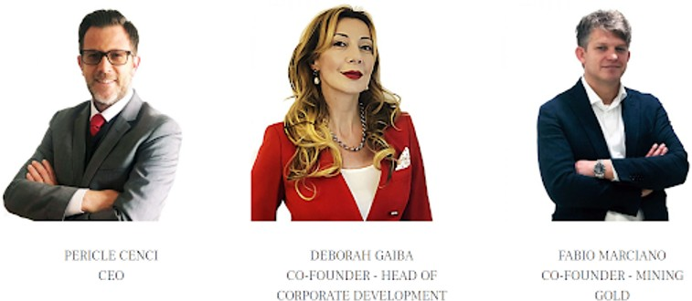






Mr Cenci brings with him a large market experience with a network of contacts and partners that will guarantee the successful activity of the venture and the full protection of its users in any and all aspects of the relation they will have with MTC. The Founding Members of Metal Trading Company are:
The development of the MTC exchange, the emission of the Token and the launch of MTCG STO is carried out in partnership with Vu-Chain, the Italian company specialized in NFT creation and blockchain.

Slide 25
FINAL DISCLAIMER
MTC, its Partners and Affiliates will always be carrying out all their operations with full re-spect to the environment and human rights framework. MTC is and will be continuously vetting its operations and its partners and affiliates operations to ensure a full respect to the environment and that no human right will be harmed in any way with a particular attention to child labour and exploitation of disadvantaged populations. This will always be the framework that will be dictating MTC present and future decisions.

